Slide 1
Strom water drainage and sewage system of indore

Slide 2
PRESENT STATUS OF THE WATER SUPPLY
According to IMC project proposal as per 2011 cencus; The city is getting its drinking water supply from various sources. The water supply as per AMRUT slip of city is around 323 MLD & rate of water supply is 97.67 LPCD. Indore water supply network serve a population of (census 2011) 19.6 lakh. The water services cover 46.65 % of the population. 53.35% of the population lives in uncovered area and there is an important City government’s effort to provide universal access to water and sanitation through uncovered area & newly added Area.
Present Water Supply sources;
Gambhir Line (Direct Supply)
ESR (3 Nos.)
Ground Borewells (350 Nos.)
There are 3 existing sources of water viz.
Narmada River (540 MLD)
Yashwant Sagar Dam (45 MLD)
Bilawali Tank (9 MLD).

Slide 3
Total Installed capacity of the surface water sources is 594 MLD and Water Drawn from these sources is 397 MLD only (i.e. 360MLD from Narmada, 34MLD from Yashwant Sagar and 3 MLD from Bilawali).The less availability of raw water is due to low water levels at Narmada River Source (dam has been constructed, but has not been used due to rehabilitation and other issues) and other surface water sources (Dam/Tank) have lesser live capacity.The other sources of water are ground water sources which cater to areas not covered by piped water supply. The Ground water sources have4945 nos. tube wells and 1004 hand pumps.
High cost of water (INR 18/kl against average cost of INR 8-10/kl in other cities) due to city getting water from Narmada River (about 70 km away and total lift of 550m)

Slide 4
PRESENT STATUS OF THE strom water drainage system of indore
Indore has 126.10 kms of underground storm water drainage network against the total Existing Road Length of 1912.2 Km (6.59% coverage). There is as Gap of 93.41% in Coverage of Storm Water Drainage Network on Master Existing Road Length. There is no underground storm water drainage in ABD area, eventually storm water ends in road side open drains, Nallahs, & river.
Weak environmental resilience and waste management, only 50% of population have access to sewerage network and 20% of roads have storm water drainage.
Environmental degradation in the city in general and contamination of natural drainage paths including Kanh river (by sewage and waste discharge) in particular coupled with inadequate public green/open spaces pose threat for the city ( Major threat for the city according to the swot analysis of smartcityindore.org )

Slide 5
PRESENT STATUS OF SEWERAGE SYSTEM
The Sewerage system in Project area has been laid during the Holkar state in 1936. There is no House Service connection at some places of the project area due to conservancy lanes. The existing sewerage network consists of 36.11 Km in length.
Overall city is not covered with sewerage generation and most of the lines are old and not able to cater the sewage. Hence, augmentation of sewerage network is required.
This existing sewerage system has a sewerage network of vitrified clay and concrete pipes varying in size from 150mm diameter to 1200mm diameter. The pattern of sewerage catchment of Indore is a typical river-based system, more so because the river Kanh.
A tributary of river Kshipra-passes through the centre strip of the city from South to North and its major tributaries meander from western and eastern direction towards the river. The terrain is generally flat and the maximum elevation difference is about 20m from upstream to downstream ground levels in the system.The sewage treatment is located at North at Kabitkhedi place with a capacity of 335 MLD (total existing 90 mid plus 245 mid recently commissioned).

Slide 6
Present Disposal
Area is connected with Primary and secondary sewerage network lines. But at some places Sewage disposal is connected with storm network or disposed off in natural drains or in street open drains.
Future Demand
Based on the demand calculation of water and standard assumption of sewage generation @ 80% of water demand, total sewage generation is calculated to be 21 MLD in 2020. The generation in 2035 and 2025 is calculated to be 26 MLD and 31 MLD respectively.
Sewerage Collection
At per present scenario, primary sewerage network is laid under JNNURM and collection system was developed by IDA & IMC in patches. The linking between Secondary to primary network is lacking. At few places, the secondary networks are disposed off in natural drain. However, to stop this disposal IMC has initiated nallah tapping project and other project to connect such disposal and connect the collection system to the primary network so that complete sewer will carry through the pipe and will be treated at STP.

Slide 7
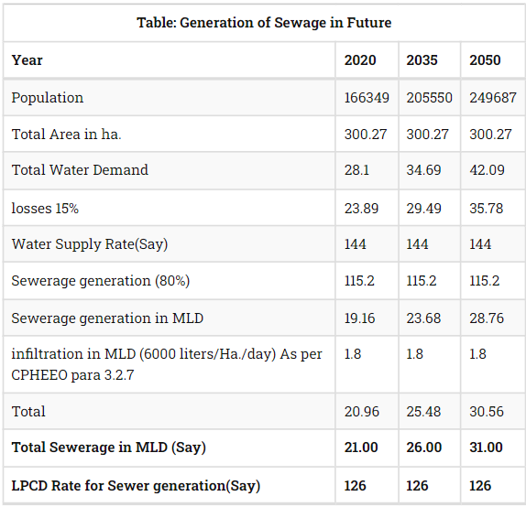

Slide 8
Causes of concern
More than 20% of sewage waste is dumped untreated into Indore's water supply, while 80% of it's sewers are under-utilized or blocked. Such conditions may increase exposure to microbial pathogens and compromise water potability.
Ideally, sewage waste is treated and disposed of by sewage treatment plants. However, due to lack of regulation and capacity in Indore, a large portion of the sewage is poured straight into the Khan river.[2] When sewage networks become clogged or overworked during monsoon season, they can cause overflow and allow sewage to disperse along the streets, especially in slum areas.
Agent of concern: Sewage waste, which can include both chemical (e.g. nitrates, phosphates, heavy metals) and biological agents (e.g. harmful pathogens).[3,4] Coliform bacteria levels were shown to be increased in the Khan river after sewage contamination Figure 3.

Slide 9
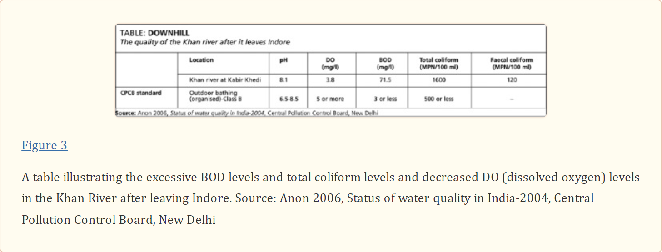
Microenvironments of concern: Outdoor bathing (organized); sections of rivers used for recreational purposes; during sewage overflow, homes and streets are of concern, especially for those who live in slums near a river, and all those who use the public water supply.
Possible sources/pathways:
River → drinking water supply → contact with humans (ingestion);
River → direct contact with humans (dermal);
River → air → contact with humans (inhalation);
River → attachment to surface → contact with humans (multiple routes); River → algal blooms → food source (e.g. fish) → contact with humans (ingestion).
Routes of exposure: Ingestion, dermal contact (via skin and eyes), and intravenous exposure, if lacerated.

Slide 10
Hostels, hotels, and auto garages are also known to dispose wastes that clog drainage pipes and contribute to mixing of sewage waste and drinking water. This may increase the risk of contamination near those areas as well. perennial river and on it two barrages viz Kayastha Khedi and Rambasa have been constructed to store the water which is mainly utilized for Irrigation purposes
Children, elderly, and immunocompromised individuals (e.g. those with HIV/AIDS) are more susceptible to sewage waste pollution in Indore's water supply. Children who are exposed to harmful pathogens such as G. Lamblia or V. cholerae can contract giardiasis or cholera and have potential adverse long-term health effects such as cancer or developmental disabilities.[6] Others exposed to such pathogens are likely to have acute effects such as diarrhea but may not face the same long-term effects as a developing child.
Laws/policies
National River Conservation Plan (1985): Policy to improve water quality and create sewage treatment plants.
Water (Prevention and Control) Act of 1974: Prevention and control of water pollution. Provides national water quality standards for drinking water and sewage treatment. Some states, including Madhya Pradesh, have recently set stricter standards to reduce sewage pollution. However, both have failed to act against violators.
Neither of these legislations were effective, which led to their dismantling in 2014.

Slide 11
References
1. Centre for Science and Environment (2011). Indore: The Water-Waste Portrait. [Last accessed on 2015 Nov 21]. Available from: http://cseindia.org/userfiles/indore_portrait.pdf .
2. Jha B. (2012, July 9). Indore, Bhopal pollutes its water resources, heavily dependent on Narmada. [Last accessed on 2015 Nov 21]. Available from: http://timesofindia.indiatimes.com/home/environment/pollution/Indore-Bhopal-pollutes-its-water-resources-heavily-dependent-on-Narmada/articleshow/14772006.cms .
3. Sharma R, Sikka J, Bajpai N, Waghela D. Impact of Domestic Sewage and Industrial Effluent on Water Quality of the Khan River, Indore (India) Pollut Res. 2012;31:289–96. [Google Scholar]
4. Gurjar M, Chourey VR, Dwivedi D, Vyas R. Physico Chemical Assessment of Groundwater in Indore City. Curr World Environ. 2013;8:117–21. [Google Scholar]
5. Dega S. (2014, November 10). Restoring Indore's Lakes to Create an Emergency Water Supply. [Last accessed on 2015 Nov 21]. Available from: https://www.rockefellerfoundation.org/blog/restoring-indores-lakes-create/
6. Petri WA, Jr, Miller M, Binder HJ, Levine MM, Dillingham R, Guerrant RL. Enteric infections, diarrhea, and their impact on function and development. The Journal of clinical investigation. 2008;118:1277. [PMC free article] [PubMed] [Google Scholar]
7. Parikh H. (2014, October 5). Slum Networking of Indore City. [Last accessed on 2015 Nov 21]. Available from: http://architexturez.net/doc/az-cf-166249 .
8. Purohit M. (2014, February 8) Solutions to Indore's water problems don't have to be so expensive! [Last accessed on 2015 Nov 21]. Available from: http://www.indiawaterportal.org/articles/solutions-indores-water-problems-dont-have-be-so-expensive .
https://timesofindia.indiatimes.com/city/indore/no-piped-drinking-water-in-72-homes/articleshow/91876891.cms
https://www.hindustantimes.com/indore/labyrinth-of-indore-s-drainage-system/story-qqqM7a0N9kNuoR2QUgaVNN.html

Slide 12
Indore is Still Very Much Water Minus!!
The Rivers Khan and Saraswati drain the city of Indore and a considerable part of the sewage would earlier also drain into these rivers.
Over the past few years, a massive programme has been undertaken to tap these open drains and outfalls, numbering in thousands, that were discharging untreated wastewater into these rivers, by laying sewers along their banks and then directing the wastewater to seven new Sewage Treatment Plants (STPs) constructed at intervals along these rivers.
Currently there are about 1100 kms of sewers in the city. There was already a group of STPs downstream of the city at Kabitkhedi along the river Khan to treat the wastewater from the sewerage system laid in the city but they were partially treating only about 100 Million Liters Per Day (MLD) of the total wastewater of 320 MLD or so that is generated as there were not enough sewers to carry the wastewater to them.
Now, with the tapping of all the thousands of outfalls and treatment of the wastewater in the seven new STPs constructed along the rivers and greater flow to the Kabitkhedi group of STPs as a consequence of new sewers being laid, 312 MLD of wastewater is being partially treated and some of this is being reused in washing roads and in maintaining the various gardens and parks while the rest is being released into the rivers (Free Press, 2021a).

Slide 13
Expenditure on sewerage and STPs was less in 2017-18 when the sewer lines were less in length and the STPs were not being run as much.
In 2018-19 the expenditure increased because more STPs began functioning and the shortfall in drainage cess increased to 48.8 percent.
The expenditure paradoxically fell in 2019-20 and so the shortfall was less at 13.5 percent. This was because the STPs were not run regularly in that year as will become clear later.
Faced with this shortfall in cost recovery, the IMC announced a hike in water taxes, to double of what they were earlier and introduced a new sewerage tax to become effective from April 2021. However, this was immediately met with opposition from the citizens and both the ruling party and opposition politicians pressurised the IMC to withdraw this proposed hike (Free Press, 2021b).
This clearly shows that the provision of centralised sewerage services on a regular basis is economically unsustainable. The finances of sewerage and sewage treatment are analysed further below to underline this economic unviability of centralised systems.
Clearly, the IMC is underspending by a very large proportion on sewerage and treatment and especially on treatment. This becomes clear once we study the actual operation of the STPs in Indore.
The total installed capacity of STPs in Indore is 402 MLD which can easily treat the 320 MLD of wastewater that is generated in the city. However, in reality this is not taking place due to shortage of funds and all the STPs are being run at much lower than design capacity and most of the wastewater is being bypassed.

Slide 14
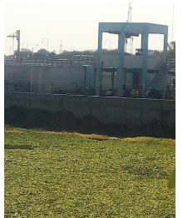
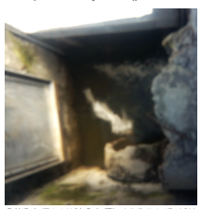
Problems at ground level
The first STP is on the River Saraswati in Bijalpur above a dam that had earlier been built on it and this is supposed to treat all the wastewater from the part of the city above it. The picture below shows that the dam below the STP is badly eutrophied with water hyacinth growth indicating that it is treating only part of the wastewater and bypassing the rest either untreated or partially treated into the dam.
The next STP to which the tapping sewers along the River Saraswati and one of its tributaries is directed is at Nahar Bhandara and this too is bypassing most of the wastewater coming to it as can be seen in picture of the chamber through which water is supposed to come into the STP. Consequently, the river near this STP is completely covered with water hyacinth
near the city centre which is known as Rajwada because of the Holkar king’s palace situated there, the two Rivers Saraswati and Khan meet. Here the flow of untreated wastewater is considerable and so the water is very polluted. As the combined River Khan flows down the city it gets more untreated waste water and reaches the main STP on its banks at Kabitkheri. Here the wastewater from the sewers of the city is once again only partially treated and mostly by passed to add to the polluted water of the river as is evident from the picture below of foaming dark polluted flow.

Slide 15
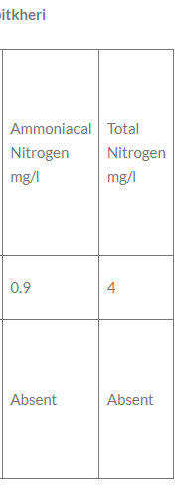
The test results establish that the water in the river at Kabitkhedi is highly polluted and not only is secondary treatment not being done properly in the STPs but tertiary treatment of chlorination is also not being properly done and that is why there is such a high level of coliform bacteria in the water.
How then did Indore get the Water Plus certification then? All the STPs were run at full capacity a fortnight prior to and during the visit of the Swachh Sarvekshan team so that the water was clean in the rivers!! Aqua harvesters were used to clean up the water hyacinth from the rivers as shown in the picture below. Once the evaluation was done and the team had left, the STPs were put back into the bypass mode and Indore became water minus again!!

Slide 16
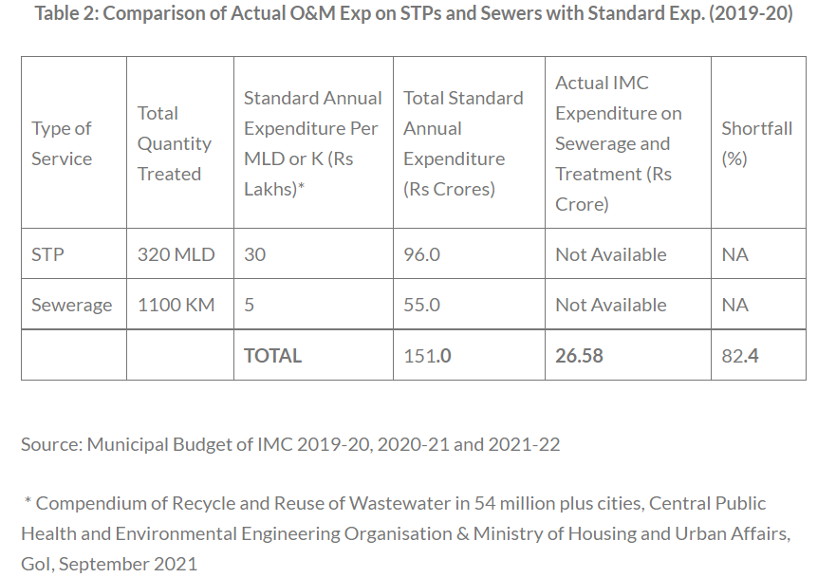

Slide 17
References
CPHEEO (2013): Manual on Sewerage and Sewage Treatment, Central Public Health and Environmental Engineering Organisation, New Delhi.
Free Press (2021a): Another First Cleanest City is Also Water Plus Now, accessed on 28.11.2021 at https://www.freepressjournal.in/indore/another-first-cleanest-city-is-also-water-plus-now
Free Press (2021b): Indore Government Suspends Hike in IMC Taxes Under Public Pressure, accessed on 28.11.2021 at https://www.freepressjournal.in/indore/indore-govt-suspends-hike-in-imc-taxes-under-public-pressure
Hindustan Times (2021): Indore Becomes India’s First Water Plus City: Here is why it Matters, accessed on 28.11.2021 at https://www.hindustantimes.com/cities/indore-news/indore-becomes-india-s-first-water-plus-city-here-s-why-it-matters-101628734719044.html
IMC (2019-20, 2020-21 and 2021-22): Budgets of Indore Municipal Corporation for 2019-20, 2020-21 & 2021-22
IMC (2021): AMRUT Service Level Improvement Plan, Indore Municipal Corporation accessed on 28.11.2021 at http://www.citybusindore.com/images/IMC_SLIP_AMRUT.pdf

Slide 18
Mordern and technical approach for the problems
Educate residents to not go into the water supply without caution and not dispose waste in it points to programs realated to water awareness.
Establish infrastructure for those in the slums to reduce the amount of outdoor defecation and contamination of the water supply (Figure 4 depicts such a toilet block funded by the World Bank) [Figure 4], and ensure household connectivity for the drainage and disposal of solid waste.
Create a better waste treatment system as well as a sewage network in Indore (this has been partially completed through the renowned slum network model)
My implementing modern approch for sewage treatment by machine learning models,
visual analysis of treatment (by imporving existing system not showing recent data)
Promoting more and more it automations .(references are given in next sides for this approaches) Indore’s Lakes to Create an Emergency Water Supply
Restoring Indore’s Lakes to Create an Emergency Water Supply restoring natural water bodies and prevention of existing evirnmental degradation.
Engage the local community to gauge the importance of the lakes in their daily lives… They told us that the lakes were a large part of their livelihoods, so we started to work with them to restore them.
by creating healthy competitions zone wise for water cleanliness .
Encouraging people to take steps thorugh social media and

Slide 19
References
https://www.rockefellerfoundation.org/blog/restoring-indores-lakes-create/
https://www.sciencedirect.com/science/article/abs/pii/S2214714421004670?via%3Dihub
https://www.researchgate.net/profile/Sani-Abba-2/publication/344154441_Modelling_of_Bunus_Regional_Sewage_Treatment_Plant_using_Machine_Learning_Approaches/links/5fc026e392851c933f64afdd/Modelling-of-Bunus-Regional-Sewage-Treatment-Plant-using-Machine-Learning-Approaches.pdf
https://pdfs.semanticscholar.org/50e5/f6afde91b2102996dba1ffdc8a09673d2cb8.pdf
http://www.climatechange.mp.gov.in/en/ongoing-projects/conservation-traditional-water-supply-sources-indore-city-under-ccap
https://sandrp.in/2021/11/29/indore-is-still-very-much-water-minus/
https://sandrp.in/2020/11/30/river-rejuvenation-in-indore-mendacity-displacing-common-sense/

